Slide 1

Tree-Planner: Efficient Close-loop Task Planning with Large Language Models
Mengkang Hu¹, Yao Mu¹, Xinmiao Yu², Mingyu Ding^{1*}, Shiguang Wu³, Wenqi Shao⁴,
Qiguang Chen², Bin Wang³, Yu Qiao⁴, Ping Luo^{1*}
¹ The University of Hong Kong, ² Harbin Institute of Technology,
³ Noah’s Ark Laboratory, ⁴ Shanghai AI Laboratory
ICLR 2024

Slide 2
Logistics
🍋 Background
📌 Task Planning
📌 Existing Methods
🍋 Motivation
🍋 Methodology
📌 Plan Generation
📌 Action Tree Construction
📌 Grounded Deciding
🍋 Experiments
📌 Environment
📌 Experimental Setup
📌 Experimental Results
📌 Analysis

Slide 3
🍋 Background

Slide 4
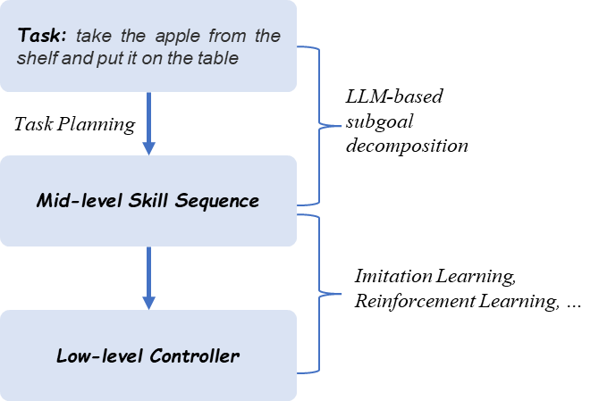
📌 Task Planning
Decompose a high-level task description (microwave salmon) into a plan consisting of mid-level actions (open fridge, grab salmon, close fridge).
We assume there is a low-level controller that can execute these mid-level actions (such as "grab cup").

Slide 5
📌 Existing Methods
Search-Based Methods：
search in a pre-defined domain (hard to scale^{)[1]}
heuristics guided search^{[2]}
learning-based task planning (representation learning, hierachical learning)^{[3]}
Generation-Based Methods: directly generate plans with LLMs
generate an entire plan before execution. ^{[4][5][6]}
dynamically generate actions at each timestep. (iterative planner) ^{[7][8][9]}

Slide 6
📌 Existing Methods - Reference
[1] Task Planning in Robotics: an Empirical Comparison of PDDL-based and ASP-based Systems. 2018
[2] A heuristic search approach to planning with temporally extended preferences. 2007
[3] Hierarchical Planning for Long-Horizon Manipulation with Geometric and Symbolic Scene Graphs
[4] Visually-Grounded Planning without Vision: Language Models Infer Detailed Plans from High-level Instructions. 2020 ACL Findings
[5] Language Models as Zero-Shot Planners: Extracting Actionable Knowledge for Embodied Agents. 2022 ICML
[6] Socratic Models: Composing Zero-Shot Multimodal Reasoning with Language
[7] Do As I Can, Not As I Say: Grounding Language in Robotic Affordances 2022.4
[8] Grounded Decoding: Guiding Text Generation with Grounded Models for Robot Control

Slide 7
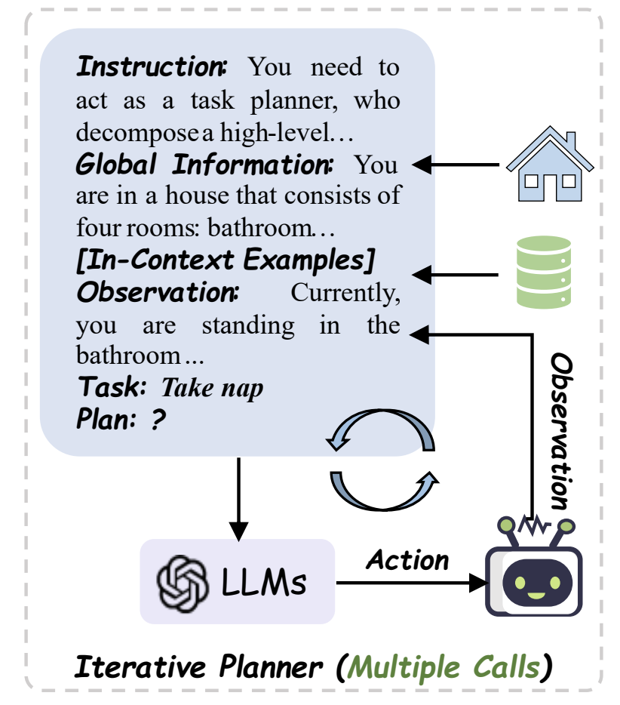
📌 Existing Methods – Iterative Planner (2.b)
Pipeline:
Prompt an LLM to generate one action at a time;
Execute the generated action and then append the obtained observation to the LLM;
Generate the next action.
When errors occur during action execution:
re-generate actions at the current timestep;^{[1][2]}
re-generate the entire plan from the initial timestep.^{[3]}
[1] Planning with large language models via corrective re-prompting.
[2] Yanjiang Guo, Yen-Jen Wang, Lihan Zha, Zheyuan Jiang, and Jianyu Chen. Doremi: Grounding language model by detecting and recovering from plan-execution misalignment, 2023.
[3] Noah Shinn, Beck Labash, and Ashwin Gopinath. Reflexion: an autonomous agent with dynamic memory and self-reflection.

Slide 8
🍋 Motivation – Existing Limitations of Iterative Planner
📌 Token Inefficiency: Due to the multi-step nature of task planning (usually involving 5-20 steps), the prompt tokens incur repeated charges, leading to high costs of tokens (token inefficiency also relates to runtime inefficiency).
📌 Correction Inefficiency: Replan with iterative planner can be viewed as a trial-and-error approach implemented at the execution-failed time step, which makes it difficult for the model to detect errors that occurred several time steps earlier.

Slide 9
🍋 Methodology

Slide 10
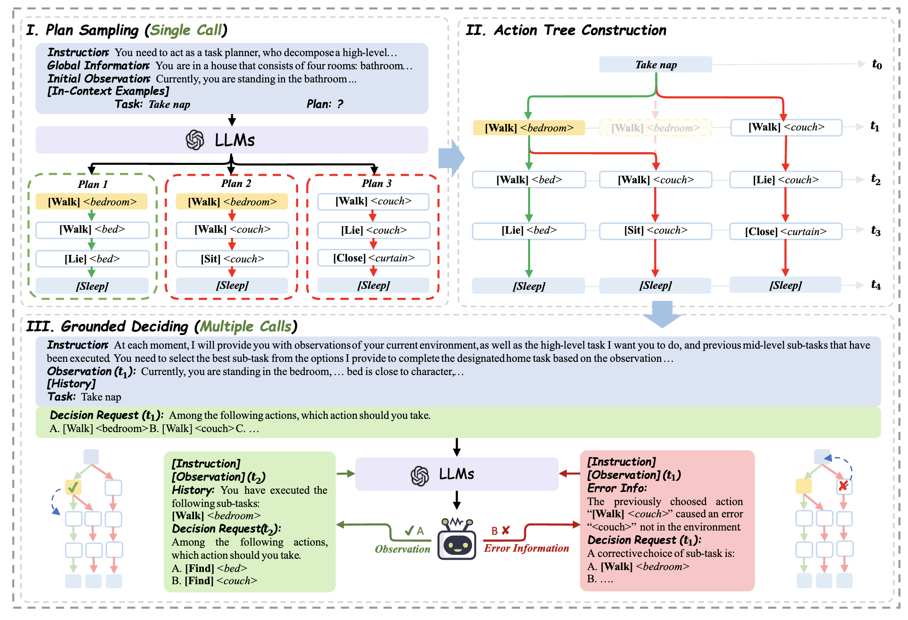
📌 Overview

Slide 11
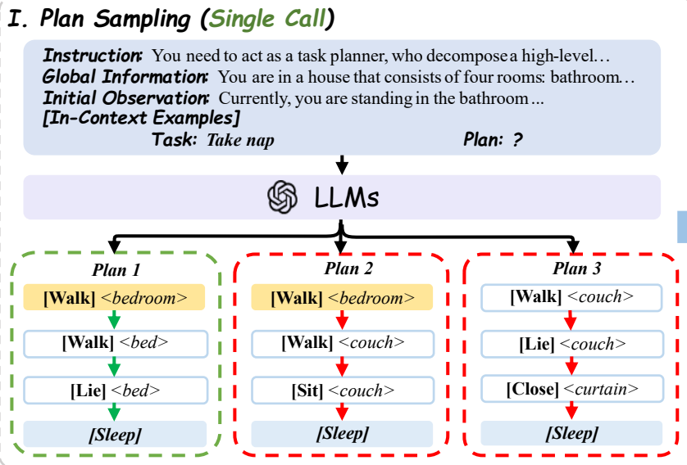
📌 Plan Sampling
LLMs trained on large-scale data encode commonsense knowledge about the real-world.
The sampled plans serve as prior knowledge for task planning

Slide 12
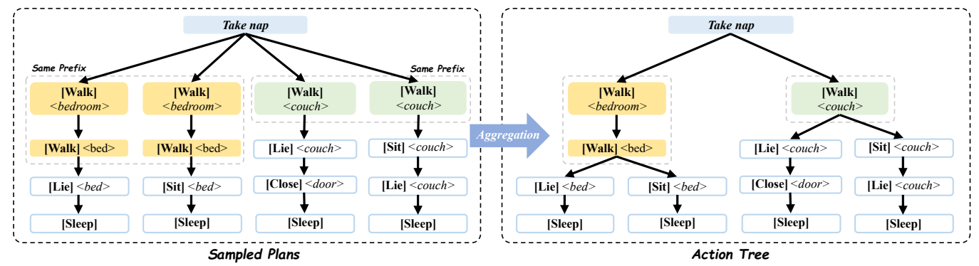
📌 Action Tree Construction
When two plans share a common prefix but differ in their actions at a specific time step, their shared prefix is aggregated into a single branch.
Benefits of Action Tree: Converting the filtering of the plan level into a search at the action level, thereby reducing the execution time in the environment.

Slide 13
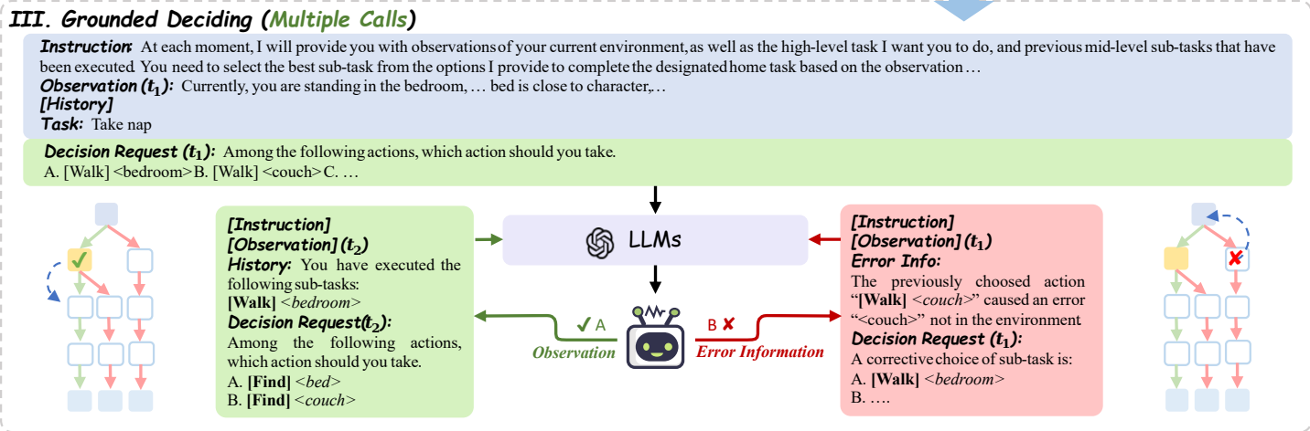
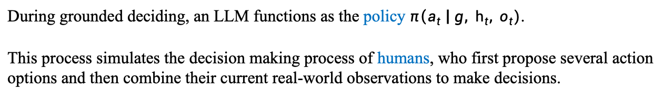
📌 Grounded Deciding
During grounded deciding, an LLM functions as the policy $π\left(a_{t} \right| g, h_{t}, o_{t})$.
This process simulates the decision making process of humans, who first propose several action options and then combine their current real-world observations to make decisions.

Slide 14
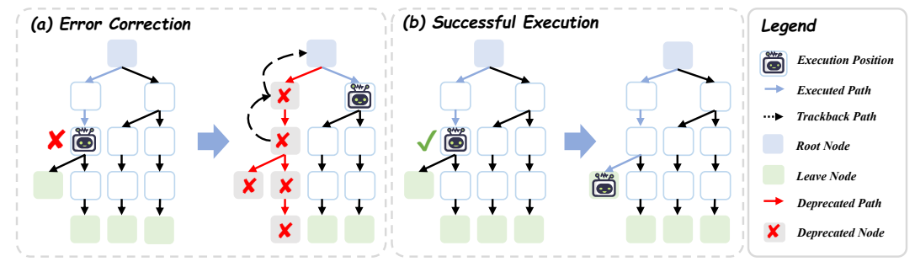
📌 Grounded Deciding – Error Correction
Left: When an error occurs, the agent tracks back and marks the nodes along the way as invalid. Afterward, it makes a new decision at the previous fork node.
Right: After the action is successfully executed, the agent makes a decision at the current node moves on to the next level.

Slide 15
🍋 Experiment

Slide 16

📌 Environment - VirtualHome
Task : Watch TV
Program:
[Walk] <television> (1)
[SwitchOn] <television> (1)
[Walk] <sofa> (1)
[Find] <controller> (1)
[Grab] <controller> (1)

Slide 17
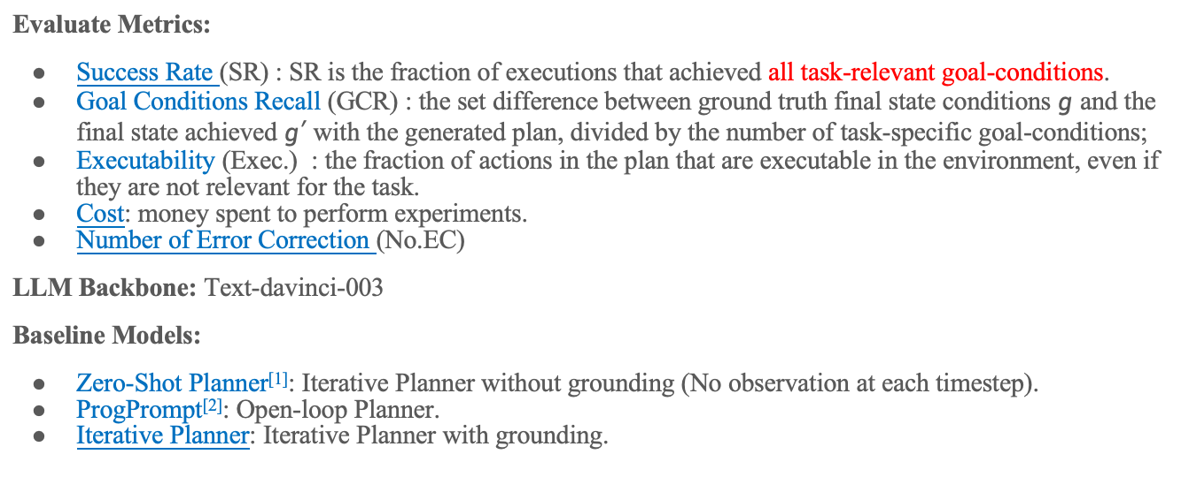
📌 Experimental Setup
Evaluate Metrics:
Success Rate (SR) : SR is the fraction of executions that achieved all task-relevant goal-conditions.
Goal Conditions Recall (GCR) : the set difference between ground truth final state conditions $g$ and the final state achieved $g′$with the generated plan, divided by the number of task-specific goal-conditions;
Executability (Exec.) : the fraction of actions in the plan that are executable in the environment, even if they are not relevant for the task.
Cost: money spent to perform experiments.
Number of Error Correction (No.EC)
LLM Backbone: Text-davinci-003
Baseline Models:
Zero-Shot Planner^{[1]}: Iterative Planner without grounding (No observation at each timestep).
ProgPrompt^{[2]}: Open-loop Planner.
Iterative Planner: Iterative Planner with grounding.
[1] Language Models as Zero-Shot Planners: Extracting Actionable Knowledge for Embodied Agents. 2022 ICML
[2] Singh I, Blukis V, Mousavian A, et al. Progprompt: Generating situated robot task plans using large language models[C]//2023 IEEE International Conference on Robotics and Automation (ICRA). IEEE, 2023: 11523-11530.

Slide 18
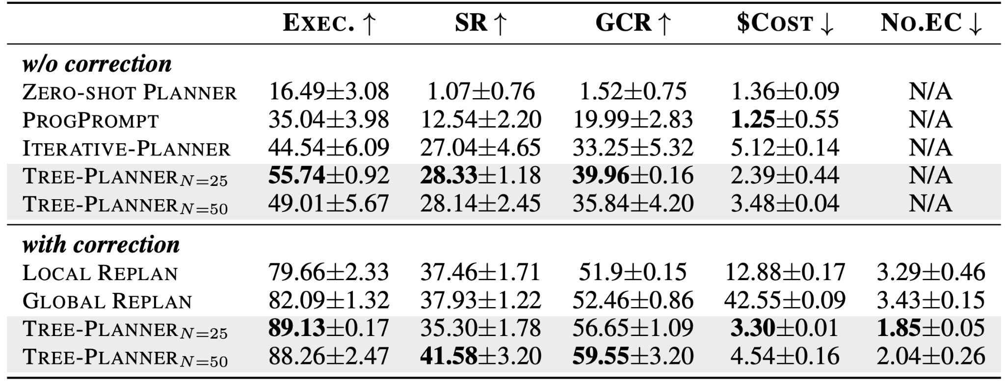
📌 Experimental Results
🟩 SOTA on success rate.
🟪 Token consumption is reduced by 92.2% compared to the previously best-performing model.
🟥 40.5% decrease in error corrections.
N represents the number of sampled plans.

Slide 19
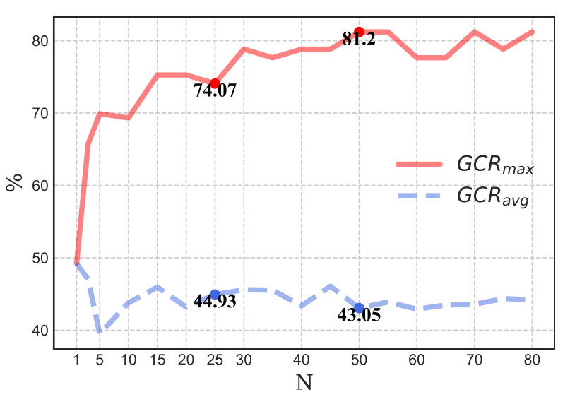
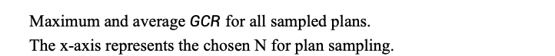
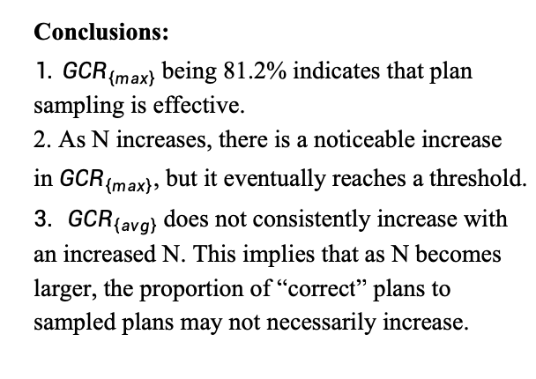
📌 Analysis – The upper limit of Plan Sampling
Conclusions:
$1. GCR_{\left\{max\right\}}$being 81.2% indicates that plan sampling is effective.
2. As N increases, there is a noticeable increase in $GCR_{\left\{max\right\}}$, but it eventually reaches a threshold.
$3. GCR_{\left\{avg\right\}}$does not consistently increase with an increased N. This implies that as N becomes larger, the proportion of “correct” plans to sampled plans may not necessarily increase.
Maximum and average $GCR$ for all sampled plans.
The x-axis represents the chosen N for plan sampling.

Slide 20
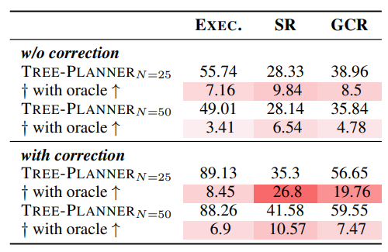
📌 Analysis – The effectiveness of Grounded Deciding
Conclusions:
1. After incorporating the gold plan, there was a significant improvement in performance.
2. The improvement in performance for Tree-Planner_{N=25} was greater than that for Tree-Planner_{N=50}.
† represents the performance improvement after adding a gold plan to action tree construction.

Slide 21
🍋 Thanks

